Slide 1


Edgar Tijerina Tamez
07/Oct/2025

Slide 2

Outline
Executive Summary
Introduction
Methodology
Results
Conclusion
Appendix

Slide 3
Executive Summary
Exploratory data analysis was conducted using a predictive approach to find patterns, distributions, correlations and anomalies, using the SpaceX REST API as the main data source. Complementary data was sourced from Wikipedia using web scrapping techniques. Data was cleaned and prepared for machine learning using One Hot Encoding. Interactive visual analytics were developed with Folium as well interactive dashboards using Plotly Dash. Machine learning pipelines were set up to test multiple classifiers, including Logistic Regression, Support Vector Machine (SVM), Decision Tree Classifier and K-Nearest Neighbors (KNN). Model hyperparameters where optimized and the results visualized on Confusion matrices.
From the exploratory data analysis we can observe that landing success rate has been increasing since 2010 reaching 80% success rate as of 2020. We can also observe that Geostationary Orbits (GTO) had the lowest success rate with 50%. All machine learning prediction models reached an 83% accuracy. The confusion matrices demonstrated the ability of the model to predict with perfect accuracy True Positives (Successful landings) but struggled with predict True Negatives (Failed landing).

Slide 4
Introduction
Launching rockets is a multi million-dollar endeavor. Right now, the space launch market is entirely dominated by SpaceX, composing over 75% of all commercial launches as of 2023. Their main advantage is their ability to reuse their rockets, cutting their costs per launch from $150 million to $97 million.
Being able to predict whether the first stage will land would give an advantage to competitors by estimating launch costs.

Slide 5

Section 1

Slide 6
Methodology
Executive Summary
Data was collected from two main sources: SpaceX API using Python’s Requests module and Wikipedia Falcon 9 launch records using BeautifulSoup.
Data was cleaned and transformed using Pandas and Numpy. One hot encoding was used to transform the data in preparation for machine learning.
EDA was performed using matplotlib and seaborn for plotting and key data points were extracted using SQL.
Interactive visual analytics were developed with Folium as well interactive dashboards using Plotly Dash.
Machine learning pipelines were set up to test multiple classification models, including Logistic Regression, Support Vector Machine (SVM), Decision Tree Classifier and K-Nearest Neighbors (KNN). Model hyperparameters where optimized and the results visualized on Confusion matrices.
Notes:
Executive Summary
Data collection methodology:
Data was collected from two main sources: SpaceX API using Python’s Requests module and Wikipedia Falcon 9 launch records using BeautifulSoup.
Data wrangling:
Data was cleaned and transformed using Pandas and Numpy. One hot encoding was used to transform the data in preparation for machine learning.
Exploratory data analysis (EDA) using visualization and SQL:
EDA was performed using matplotlib and seaborn for plotting and key data points where extracted using SQL
Perform interactive visual analytics using Folium and Plotly Dash
Perform predictive analysis using classification models
How to build, tune, evaluate classification models

Slide 7
Data Collection
Start
Data was collected from two main sources: SpaceX API using Python’s Requests module and Wikipedia Falcon 9 launch records using BeautifulSoup.
Data Sources
SpaceX API
Wikipedia Falcon 9 Launch Records
Requests
BeautifulSoup
Dataset_part_1.csv
Spacex_web_scraped.csv
Notes:
Describe how data sets were collected.
You need to present your data collection process use key phrases and flowcharts

Slide 8
Data Collection – SpaceX API
The primary source of data is the SpaceX REST API -> api.spacexdata.com/v4/
Its key endpoints are:
/launches/past -> past launch data (main dataset).
/capsules, /cores, /payloads, /launchpads -> detailed info by ID.
Using Python requests we obtained JSON objects
By using json_normalise from Pandas DataFrame we transform the data into a tabular structure
Notebook link:
https://github.com/EdgarHTT/Applied_Data_Science_Capstone/blob/main/jupyter-labs-spacex-data-collection-api.ipynb
Notes:
Present your data collection with SpaceX REST calls using key phrases and flowcharts
Add the GitHub URL of the completed SpaceX API calls notebook (must include completed code cell and outcome cell), as an external reference and peer-review purpose

Slide 9
Data Collection – SpaceX API
Requests
GET
Endpoint | https://api.spacexdata.com/v4/launches/past
Response | JSON response
Endpoint | https://api.spacexdata.com/v4/cores/{core}
Response | block reuse_count serial landing_success, landing_type flight gridfins reused legs landpad
Endpoint | https://api.spacexdata.com/v4/payloads/{payload}
Response | mass_kg orbit
response.json()
response
Endpoint | https://api.spacexdata.com/v4/launchpads/{launchpad}
Response | Longitude Latitude Name
GET
data
Endpoint | https://api.spacexdata.com/v4/rockets/{rocket}
Response | name
pd.json_normalize(data)
dataframe
Filter for only Falcon 9
Replace Null values in Payload mass with mean
launch_dict
Notebook link:
https://github.com/EdgarHTT/Applied_Data_Science_Capstone/blob/main/jupyter-labs-spacex-data-collection-api.ipynb
Dataset_part_1.csv
Notes:
Present your data collection with SpaceX REST calls using key phrases and flowcharts
Add the GitHub URL of the completed SpaceX API calls notebook (must include completed code cell and outcome cell), as an external reference and peer-review purpose

Slide 10
Data Collection - Scraping
Endpoint | https://en.wikipedia.org/wiki/List_of_Falcon_9_and_Falcon_Heavy_launches
Response | HTTP
Requests was used in tandem with BeautifulSoup to parse and scrape the List of Falcon 9 and Falcon Heavy launches from Wikipedia. The parsed data was converted into a Pandas Dataframe and stored for further use.
Requests
GET
soup obj
BeautifulSoup()
response
soup.find_all(‘table’)[2]
first_launch_table
column_names
Extraction functions
Spacex_web_scraped.csv
Pd.DataFrame()
launch_dict
Notebook link:
https://github.com/EdgarHTT/Applied_Data_Science_Capstone/blob/main/jupyter-labs-webscraping.ipynb
Notes:
Present your web scraping process using key phrases and flowcharts
Add the GitHub URL of the completed web scraping notebook, as an external reference and peer-review purpose

Slide 11
Data Wrangling
Data Analysis
pd.read_csv
Dataset_part_1.csv
start
% missing values
Data types
dataFrame
dataset_part_2.csv
end
# of launches on each launch site
Success:
1
join
# of each orbit
# of each landing outcome
outcome
Landing class
Landing success rate
Failure:
0
class mean
Notebook:
https://github.com/EdgarHTT/Applied_Data_Science_Capstone/blob/main/labs-jupyter-spacex-Data%20wrangling.ipynb
Notes:
Describe how data were processed
You need to present your data wrangling process using key phrases and flowcharts
Add the GitHub URL of your completed data wrangling related notebooks, as an external reference and peer-review purpose

Slide 12
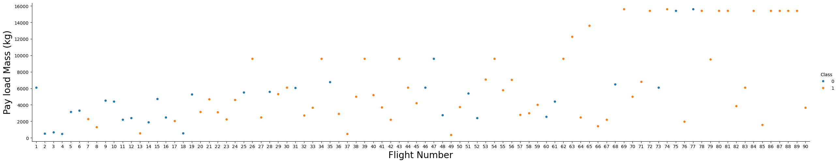
EDA with Data Visualization
As part of the exploratory data analysis, visualizations are developed to obtain a deeper understanding and find insights.
By plotting Flight number against Payload mass, we can observe that the success rate of each launch increases. Payload mass and landing success doesn’t seem to be correlated
Notes:
Summarize what charts were plotted and why you used those charts
Add the GitHub URL of your completed EDA with data visualization notebook, as an external reference and peer-review purpose

Slide 13
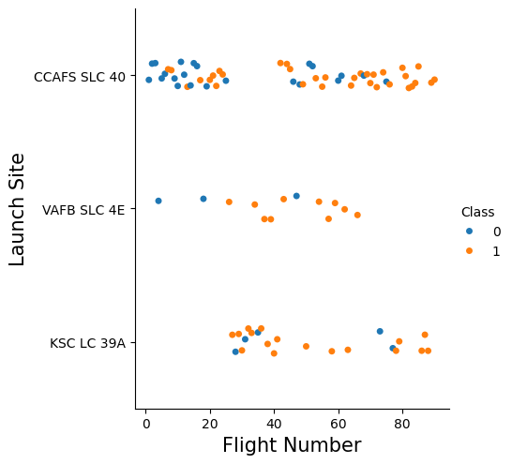
EDA with Data Visualization
By visualizing the relationship between flight number and launch site, we can observe that the first launches done by SpaceX was on Cape Canaveral and that most of their failures were done there.
Notes:
Summarize what charts were plotted and why you used those charts
Add the GitHub URL of your completed EDA with data visualization notebook, as an external reference and peer-review purpose

Slide 14
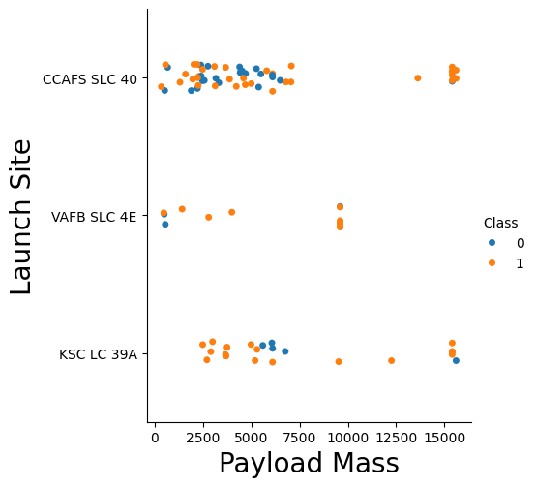
EDA with Data Visualization
And by plotting against payload mass, we can see that for the VAFB-SLC launch site no heavy payload rockets was launched.
Notes:
Summarize what charts were plotted and why you used those charts
Add the GitHub URL of your completed EDA with data visualization notebook, as an external reference and peer-review purpose

Slide 15
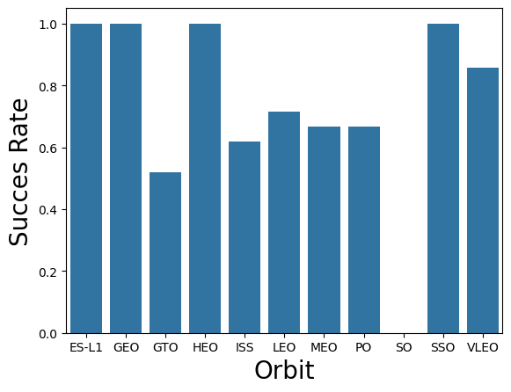
EDA with Data Visualization
By plotting the success rate of each orbit, we can see that Geo Stationary Orbits (GTO) are the most difficult launches to land.
Notes:
Summarize what charts were plotted and why you used those charts
Add the GitHub URL of your completed EDA with data visualization notebook, as an external reference and peer-review purpose

Slide 16
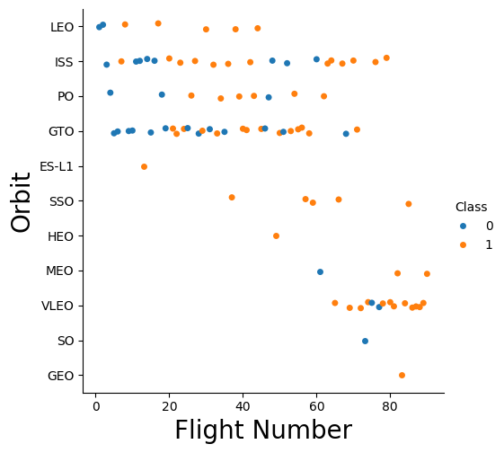
EDA with Data Visualization
As of now the most common mission by SpaceX is Very Low Earth Orbit (VLEO). This orbit is most common for satellite missions like their Starlink service
Notes:
Summarize what charts were plotted and why you used those charts
Add the GitHub URL of your completed EDA with data visualization notebook, as an external reference and peer-review purpose

Slide 17
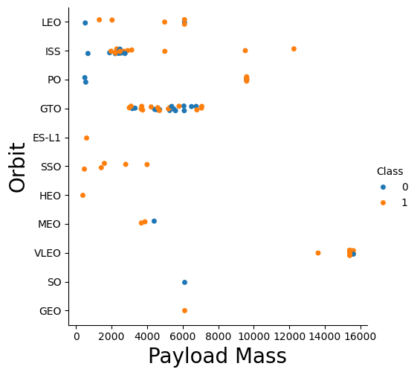
EDA with Data Visualization
With heavy payloads the successful landing rate are more for Polar, LEO and ISS.
However, for GTO, it’s difficult to distinguish between successful and unsuccessful landings
Notes:
Summarize what charts were plotted and why you used those charts
Add the GitHub URL of your completed EDA with data visualization notebook, as an external reference and peer-review purpose

Slide 18
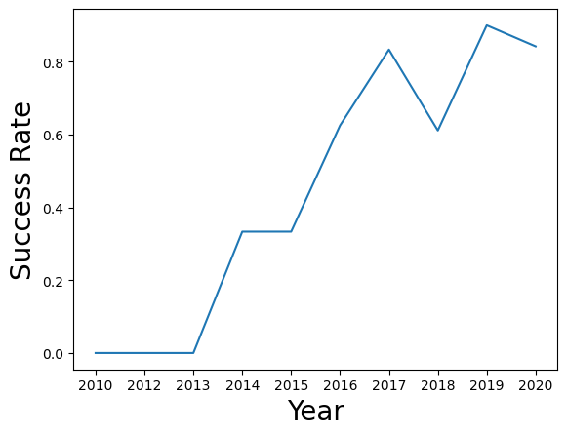
EDA with Data Visualization
Finally, we can observe that the success rate kept increasing from 2013 till 2020
Notes:
Summarize what charts were plotted and why you used those charts
Add the GitHub URL of your completed EDA with data visualization notebook, as an external reference and peer-review purpose

Slide 19
EDA with SQL
Using bullet point format, summarize the SQL queries you performed
Add the GitHub URL of your completed EDA with SQL notebook, as an external reference and peer-review purpose

Slide 20
Build an Interactive Map with Folium
Summarize what map objects such as markers, circles, lines, etc. you created and added to a folium map
Explain why you added those objects
Add the GitHub URL of your completed interactive map with Folium map, as an external reference and peer-review purpose

Slide 21
Build a Dashboard with Plotly Dash
Summarize what plots/graphs and interactions you have added to a dashboard
Explain why you added those plots and interactions
Add the GitHub URL of your completed Plotly Dash lab, as an external reference and peer-review purpose

Slide 22
Predictive Analysis (Classification)
Summarize how you built, evaluated, improved, and found the best performing classification model
You need present your model development process using key phrases and flowchart
Add the GitHub URL of your completed predictive analysis lab, as an external reference and peer-review purpose

Slide 23
Results
Exploratory data analysis results
Interactive analytics demo in screenshots
Predictive analysis results

Slide 24

Section 2

Slide 25
Flight Number vs. Launch Site
Show a scatter plot of Flight Number vs. Launch Site
Show the screenshot of the scatter plot with explanations

Slide 26
Payload vs. Launch Site
Show a scatter plot of Payload vs. Launch Site
Show the screenshot of the scatter plot with explanations

Slide 27
Success Rate vs. Orbit Type
Show a bar chart for the success rate of each orbit type
Show the screenshot of the scatter plot with explanations

Slide 28
Flight Number vs. Orbit Type
Show a scatter point of Flight number vs. Orbit type
Show the screenshot of the scatter plot with explanations

Slide 29
Payload vs. Orbit Type
Show a scatter point of payload vs. orbit type
Show the screenshot of the scatter plot with explanations

Slide 30
Launch Success Yearly Trend
Show a line chart of yearly average success rate
Show the screenshot of the scatter plot with explanations

Slide 31
All Launch Site Names
Find the names of the unique launch sites
Present your query result with a short explanation here

Slide 32
Launch Site Names Begin with 'CCA'
Find 5 records where launch sites begin with `CCA`
Present your query result with a short explanation here

Slide 33
Total Payload Mass
Calculate the total payload carried by boosters from NASA
Present your query result with a short explanation here

Slide 34
Average Payload Mass by F9 v1.1
Calculate the average payload mass carried by booster version F9 v1.1
Present your query result with a short explanation here

Slide 35
First Successful Ground Landing Date
Find the dates of the first successful landing outcome on ground pad
Present your query result with a short explanation here

Slide 36
Successful Drone Ship Landing with Payload between 4000 and 6000
List the names of boosters which have successfully landed on drone ship and had payload mass greater than 4000 but less than 6000
Present your query result with a short explanation here

Slide 37
Total Number of Successful and Failure Mission Outcomes
Calculate the total number of successful and failure mission outcomes
Present your query result with a short explanation here

Slide 38
Boosters Carried Maximum Payload
List the names of the booster which have carried the maximum payload mass
Present your query result with a short explanation here

Slide 39
2015 Launch Records
List the failed landing_outcomes in drone ship, their booster versions, and launch site names for in year 2015
Present your query result with a short explanation here

Slide 40
Rank Landing Outcomes Between 2010-06-04 and 2017-03-20
Rank the count of landing outcomes (such as Failure (drone ship) or Success (ground pad)) between the date 2010-06-04 and 2017-03-20, in descending order
Present your query result with a short explanation here

Slide 41

Section 3

Slide 42
<Folium Map Screenshot 1>
Replace <Folium map screenshot 1> title with an appropriate title
Explore the generated folium map and make a proper screenshot to include all launch sites’ location markers on a global map
Explain the important elements and findings on the screenshot

Slide 43
<Folium Map Screenshot 2>
Replace <Folium map screenshot 2> title with an appropriate title
Explore the folium map and make a proper screenshot to show the color-labeled launch outcomes on the map
Explain the important elements and findings on the screenshot

Slide 44
<Folium Map Screenshot 3>
Replace <Folium map screenshot 3> title with an appropriate title
Explore the generated folium map and show the screenshot of a selected launch site to its proximities such as railway, highway, coastline, with distance calculated and displayed
Explain the important elements and findings on the screenshot

Slide 45

Section 4

Slide 46
<Dashboard Screenshot 1>
Replace <Dashboard screenshot 1> title with an appropriate title
Show the screenshot of launch success count for all sites, in a piechart
Explain the important elements and findings on the screenshot

Slide 47
<Dashboard Screenshot 2>
Replace <Dashboard screenshot 2> title with an appropriate title
Show the screenshot of the piechart for the launch site with highest launch success ratio
Explain the important elements and findings on the screenshot

Slide 48
<Dashboard Screenshot 3>
Replace <Dashboard screenshot 3> title with an appropriate title
Show screenshots of Payload vs. Launch Outcome scatter plot for all sites, with different payload selected in the range slider
Explain the important elements and findings on the screenshot, such as which payload range or booster version have the largest success rate, etc.

Slide 49

Section 5

Slide 50
Classification Accuracy
Visualize the built model accuracy for all built classification models, in a bar chart
Find which model has the highest classification accuracy

Slide 51
Confusion Matrix
Show the confusion matrix of the best performing model with an explanation

Slide 52
Conclusions
Point 1
Point 2
Point 3
Point 4
…

Slide 53
Appendix
Include any relevant assets like Python code snippets, SQL queries, charts, Notebook outputs, or data sets that you may have created during this project

Slide 54


